Slide 1
THE EFFECTS OF MICROPLASTICS ON HUMAN HEALTH IN INDIA
By Samruddhi Tawade
Research mentor: dr. vetria byrd

Slide 2
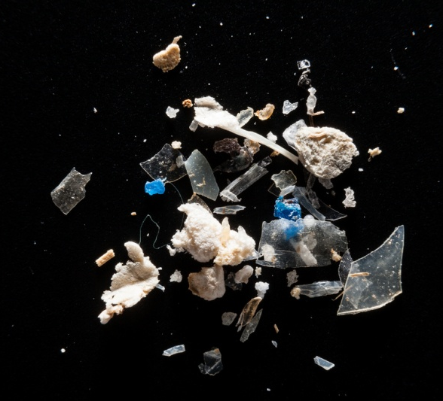


What is known about microplastics?
Plastics >5mm in length
Transported through water, food, and air
Few studies linking health issues to microplastics
More plastic pollution = more microplastics
This Photo by Unknown Author is licensed under CC BY

Slide 3

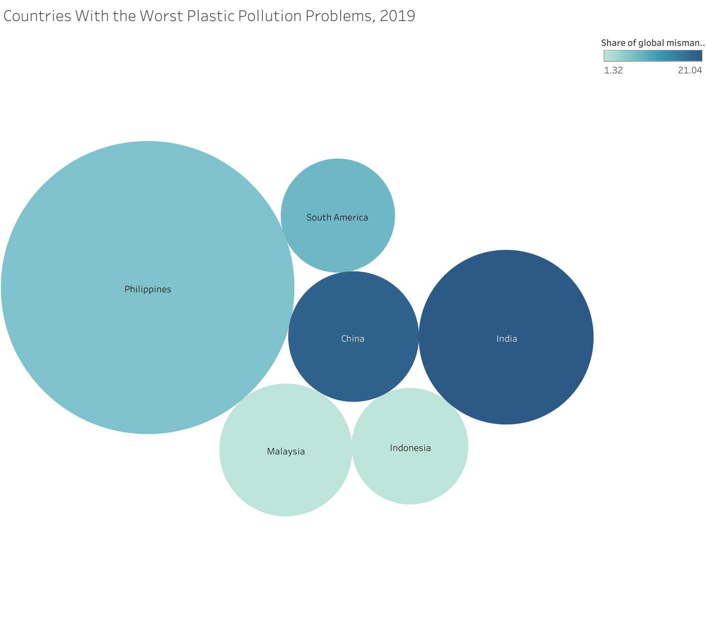
WHY INDIA?
Holds the largest share for mismanaged plastic waste
Philippines release more plastic into the ocean, but only account for 4% of world’s plastic pollution
India accounts for 12%
Focusing on health effects of extensive plastic pollution, so India seemed like the better choice
Data from: Hannah Ritchie and Max Roser (2018) - "Plastic Pollution". Published online at OurWorldInData.org. Retrieved from: 'https://ourworldindata.org/plastic-pollution' [Online Resource]

Slide 4
Health effects of microplastics
Chose 3 effects to focus on based on redundancy in other research papers and relevance to this study
Tuberculosis
Breast Cancer
Lung Cancer
Will be looking at plastic pollution on the ground as well as air pollution, as both are strong sources of microplastic transmission

Slide 5
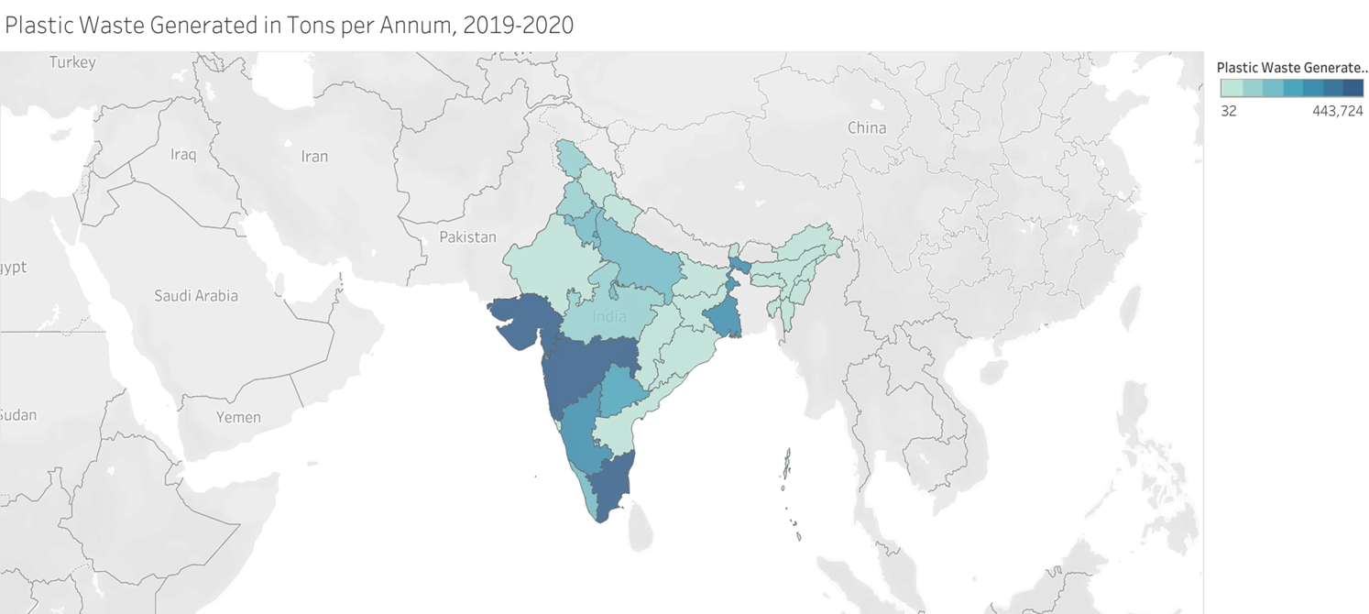
Plastic waste generated in TPA, 2019-2020
Maharashtra and Gujarat, and Tamil Nadu seem to generate the most plastic waste
Predict that cancer and tuberculosis rates will be high in this region

Slide 6

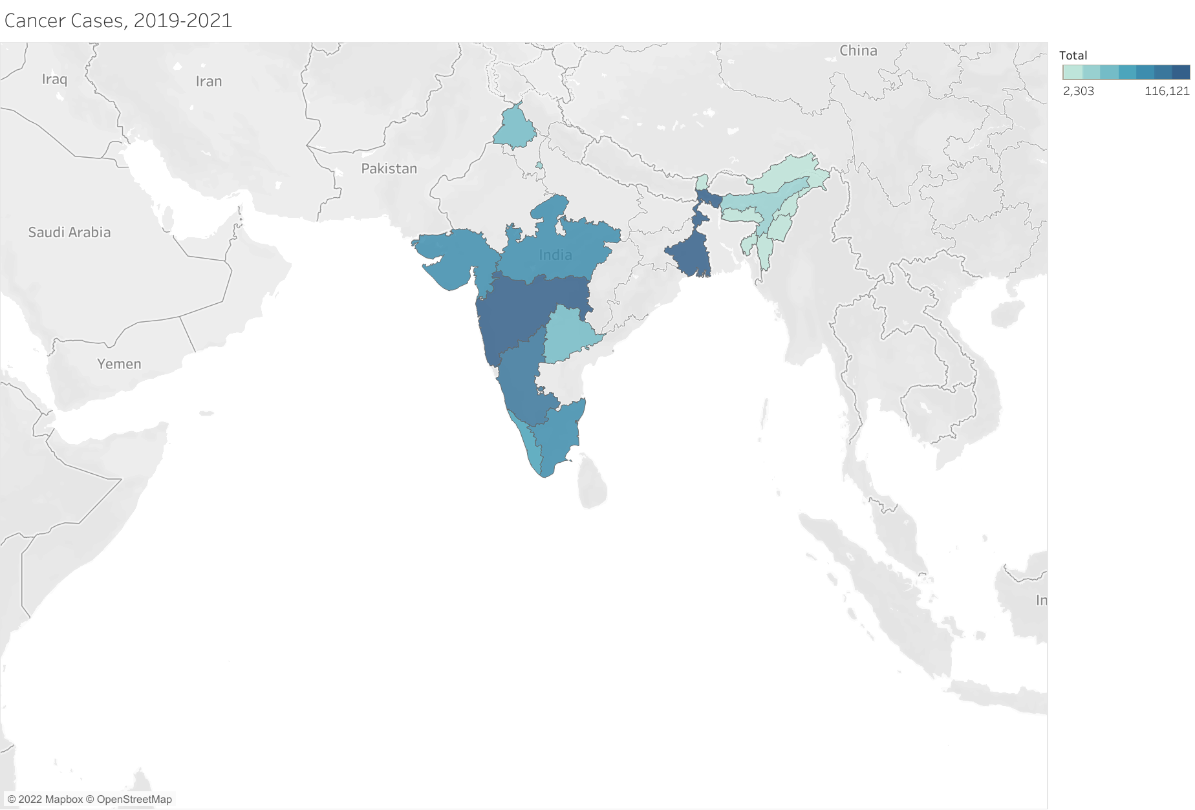
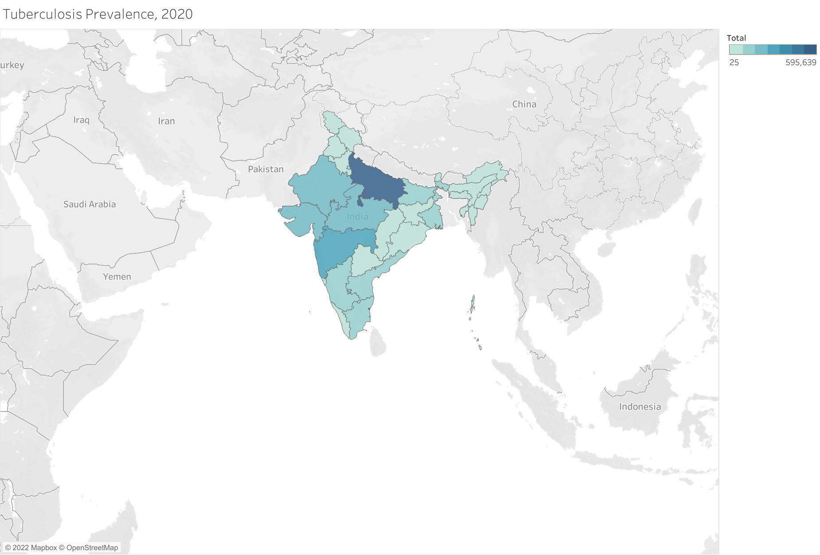
Cancer cases and tb prevalence, 2019-2021
Data was not available for each state, but based on the states of interest, trends seem to correlate
Data did not match up as expected. Uttar Pradesh had a severe outbreak of TB, while other states seemed to be more mild.

Slide 7

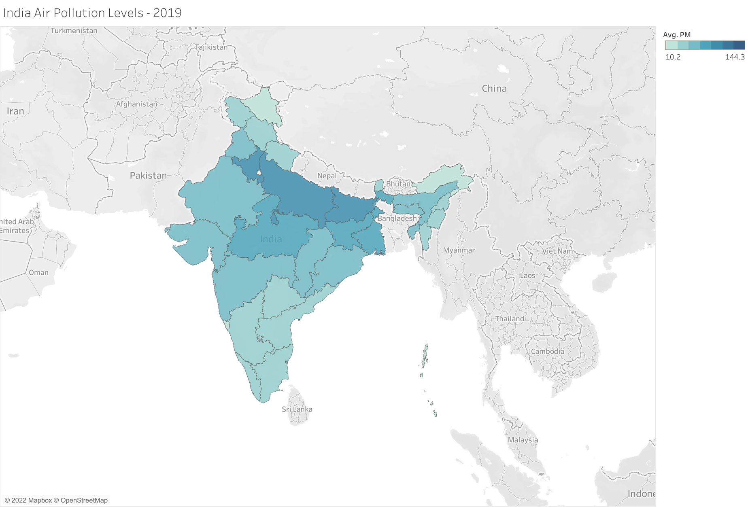
AVERAGE AQI RATING BY STATE, 2019
Don’t be fooled by the lighter colors – even the lightest states on this map are considered unhealthy by WHO standards!
WHO standards top off at 10
India raised the bar to 40

Slide 8
Cancer cases and tb prevalence, 2019-2021
Cancer trends again seem to correlate with AQI data, considering the fact that much of the air is extremely unhealthy to breathe
Data seemed to match with TB data as well, suggesting that TB can be contracted more easily through air pollution

Slide 9

Findings and analysis + Next steps
TB and plastic pollution on the ground do not seem to have a strong correlation, but cancer and ground pollution do
Cancer type for each individual case was not given, however, summarized reports of most prevalent cancer types were available on the national cancer registry
Lung cancer and breast cancer were among the top five listed in each state given, suggesting that plastic pollution has an impact on cancer rates
Study suggests that microplastics do have an impact on the prevalence of cancer and tuberculosis, to an extent.
Next steps would be to explore different countries, such as the Philippines, as they also have a severe plastic problem, to further solidify the proof that microplastics are linked to cancer and tuberculosis.
With this data, significant advancements could be made in targeting the problem at its source, while providing reliable help to the less fortunate in similar situations.

